Slide 1
Software Design & Architecture
Lecture # 11
UML Activity Diagrams and Modeling

Slide 2
Introduction
A UML activity diagram shows sequential and parallel activities in a process
They are useful for modeling business processes, workflows, data flows, and complex algorithms

Slide 3
Introduction
Activity diagrams are used to model the dynamic aspects of a system
It is essentially a flowchart
Showing flow of control from activity to activity
In many ways UML Activity diagrams are the object-oriented equivalent of flow charts and data-flow diagrams (DFDs)
Notes:
14

Slide 4
Basic UML Activity Diagram Notation
Basic UML activity diagram notation is shown on next slide, illustrating an action, partition/swimlane, fork, join, and object node
In essence, this diagram shows a sequence of actions, some of which may be parallel
Most of the notation is self-explanatory; two subtle points:
once an action is finished, there is an automatic outgoing transition
the diagram can show both control flow and data flow

Slide 6
Basic UML Activity Diagram Notation
When an action or an activity completes, flow of control passes immediately to the next action or activity
A flow of control has to start and end someplace
initial state -- a solid ball
stop state -- a solid ball inside a circle

Slide 7
Basic UML Activity Diagram Notation
Each partition/swimlane is divided from its neighbor by a vertical solid line
Each swimlane has a name unique within its diagram
Each swimlane may represent some real-world entity
Each swimlane may be implemented by one or more classes
Every activity belongs to exactly one swimlane, but transitions may cross lanes

Slide 8
How to Apply Activity Diagrams?
A UML activity diagram offers rich notation to show a sequence of activities, including parallel activities
It may be applied to any perspective or purpose, but is popular for visualizing business workflows and processes, and use cases
UML activity diagrams can be used for data flow modeling, replacing traditional DFD notation

Slide 9
Data Flow Modeling

Slide 10
Data Flow Modeling
Applying activity diagram notation to show a data flow model.

Slide 11
More UML Activity Diagram Notation
How to show that an activity is expanded in another activity diagram?
Use the rake symbol
An activity will be expanded in another diagram.

Slide 12
More UML Activity Diagram Notation
How to show conditional branches?
Use the decision symbol
The related merge symbol shows how flows can come back together

Slide 13
More UML Activity Diagram Notation
The expansion of an activity.

Slide 14
More UML Activity Diagram Notation
Signals are useful, for example, when you need to model events such as time triggering an action, or a cancellation request

Slide 15
More UML Activity Diagram Notation

Slide 16
Guidelines
A few guidelines have emerged in activity modeling; these include:
This technique proves most valuable for very complex processes, usually involving many parties. Use-case text suffices for simple processes.
If modeling a business process, take advantage of the "rake" notation and sub-activity diagrams. On the first overview "level 0" diagram, keep all the actions at a very high level of abstraction, so that the diagram is short and sweet. Expand the details in sub-diagrams at the "level 1" level, and perhaps even more at the "level 2" level, and so forth.

Slide 17
Guidelines
Related to the above, strive to make the level of abstraction of action nodes roughly equal within a diagram.
As a poor counter-example, suppose in a "level 0" diagram there is an action node labeled "Deliver Order." And, a second action node "Calculate Tax."
Those are very different levels of abstraction.

Slide 18
NextGen Activity Diagram
The partial model on next slide illustrates applying the UML to the Process Sale use case process
I've shown this case-study example for completeness, but in reality would not bother to create this, as the use case text and relative simplicity of the process make it of marginal value

Slide 20
Activity Diagrams in the UP
One of the UP disciplines is Business Modeling; its purpose is to understand and communicate "the structure and the dynamics of the organization in which a system is to be deployed”
A key artifact of the Business Modeling discipline is the Business Object Model (a superset of the UP Domain Model), which essentially visualizes how a business works, using UML class, sequence, and activity diagrams
Thus, activity diagrams are especially applicable within the Business Modeling discipline of the UP

Slide 21
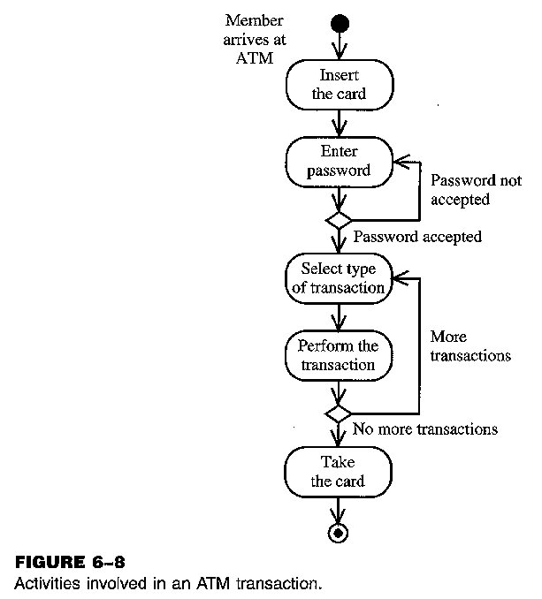
Example of Activity Diagram

Slide 22
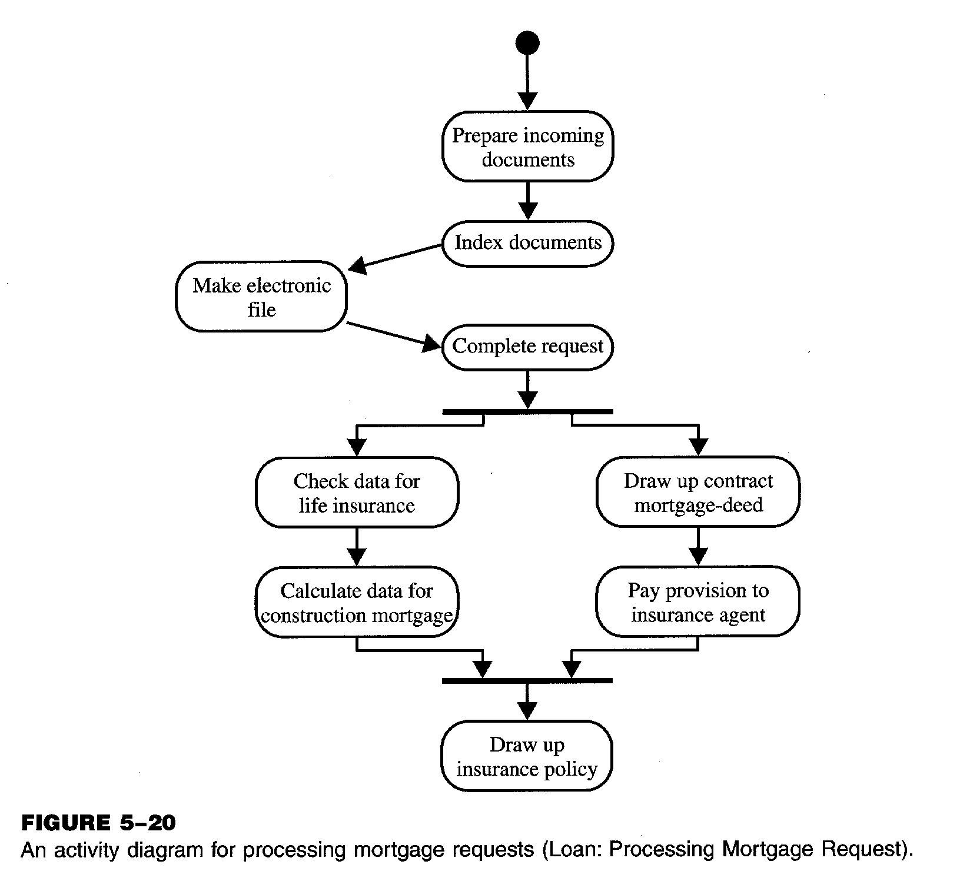
Example of Activity Diagram

Slide 23
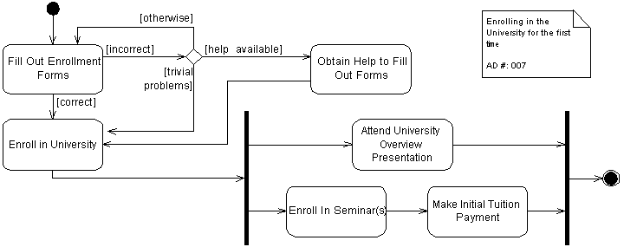
Example of an Activity Diagram
Guideline: Place the stating point in the top-left corner
Guideline: Each transition leaving a decision point must have a Guard

Slide 24
Recommended Reading
Chapter # 28 from Applying UML and Patterns: An Introduction to Object-Oriented Analysis and Design and Iterative Development by Craig Larman, 3rd Edition

